Slide 1





Mapping Training
Shared Services Center
.
Global Integration & eServices
Nanjing, Apr. 2017

Slide 2
General Mapping Steps
What is Mapping?
Shared Services Center | Global Integration & eServices

Slide 3



General Mapping Steps
What is routing?
Transfer the files
Incoming file
outgoing file
SWORD
What is mapping?
Translate the files
If the file type or content
need to be converted, a map
need to be integrated into
routing
Customer A
Customer B
map
Shared Services Center | Global Integration & eServices

Slide 4
General Mapping Steps
A Simple Map Example
Shared Services Center | Global Integration & eServices

Slide 5
General Mapping Steps
Incoming file
H:11111:
L:Hammer:11.00:
L:Saw:22.00:
T:2:33.00:
H:22222:
L:Piano:111.00:
L:Violin:222.00:
L:Kazoo:333.00:
T:3:666.00:
Outgoing file
L:Hammer:11.00:
L:Saw:22.00:
L:Piano:111.00:
L:Violin:222.00:
L:Kazoo:333.00:
What are the differences?
The “L.” record is picked
The other records are removed
Shared Services Center | Global Integration & eServices

Slide 6
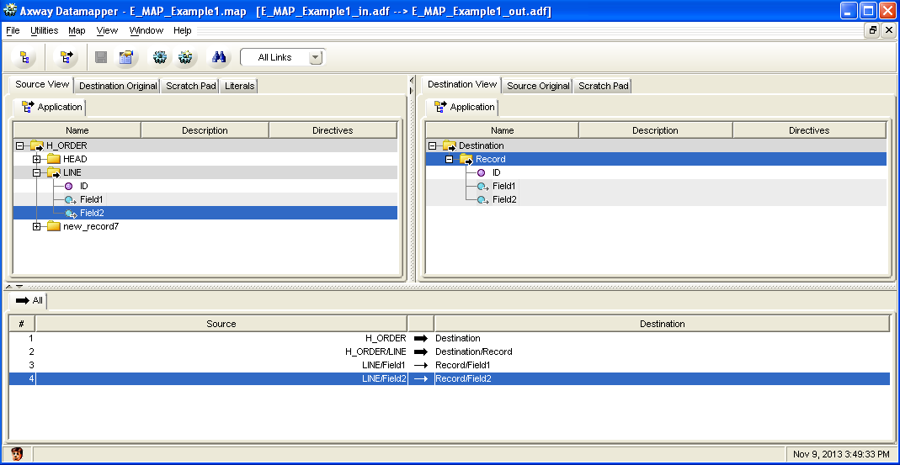
General Mapping Steps
Development tool
Source ADF
Destination ADF
Application Data Format:
Import/export the files
Same structure as the files
links
Assign the value from
“source” to “destination”
Shared Services Center | Global Integration & eServices

Slide 7
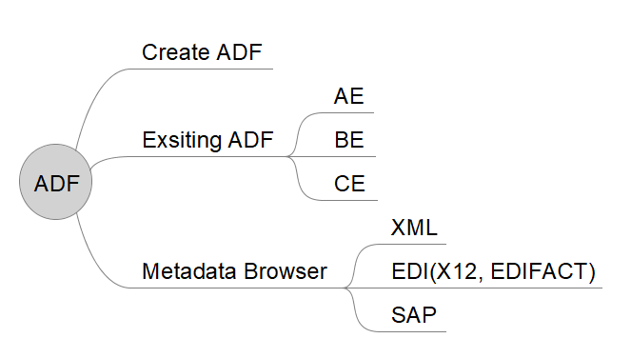
ADF
Schenker China Ltd.

Slide 8
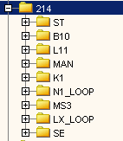
ADF
CE
upgrade base on latest version
XML
- XSD/DTD Location
/app/sword/shared/axway/local/datamapper/import/xsd/TSC_NKG/
/app/sword/shared/axway/local/datamapper/import/dtd/TSC_NKG/
- Configure FIle
/app/sword/shared/axway/local/config/ACxml.cfg
X12, EDIFACT
Add a record for message
CE ADFs
Schenker China Ltd.

Slide 9
General Mapping Steps
File Structure Analysis
Shared Services Center | Global Integration & eServices

Slide 10
General Mapping Steps
What is the structure of the first message?
H:11111:
L:Hammer:11.00:
L:Saw:22.00:
T:2:33.00:
H:22222:
L:Piano:111.00:
L:Violin:222.00:
L:Kazoo:333.00:
T:3:666.00:
Message
Message
Record
Head
Line
Tail
Field
How many occurrence of “Message” in the file?
How many occurrence of “Line” in the first “Message”?
How many occurrence of “Line” in the file?
Remarks:
The value of different occurrence is different
The structure of different occurrence is the same
Shared Services Center | Global Integration & eServices

Slide 11
General Mapping Steps
H:11111:
L:Hammer:11.00:
L:Saw:22.00:
T:2:33.00:
H:22222:
L:Piano:111.00:
L:Violin:222.00:
L:Kazoo:333.00:
T:3:666.00:
Record Identifier :
Start of record
Record delimiter:
End of record
Field delimiter
Shared Services Center | Global Integration & eServices

Slide 12
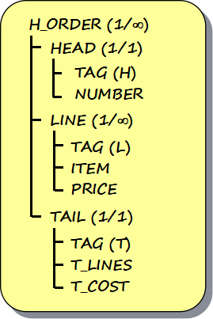
General Mapping Steps
H:11111:
L:Hammer:11.00:
L:Saw:22.00:
T:2:33.00:
H:22222:
L:Piano:111.00:
L:Violin:222.00:
L:Kazoo:333.00:
T:3:666.00:
Message
Record
Field
Record delimiter
Field delimiter
Record Identifier
Shared Services Center | Global Integration & eServices

Slide 13
General Mapping Steps
How to create a new ADF?
Shared Services Center | Global Integration & eServices

Slide 14

General Mapping Steps
  Step1: analyze the structure of the data
Shared Services Center | Global Integration & eServices

Slide 15
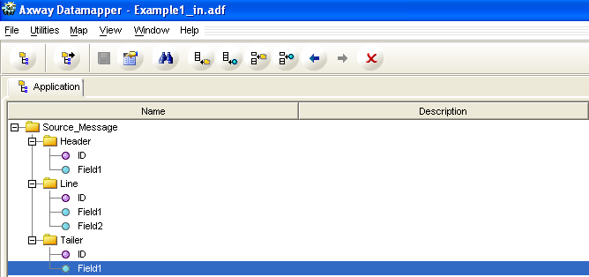
General Mapping Steps
    Step2: create the file structure
    Field
    Record
Shared Services Center | Global Integration & eServices

Slide 16
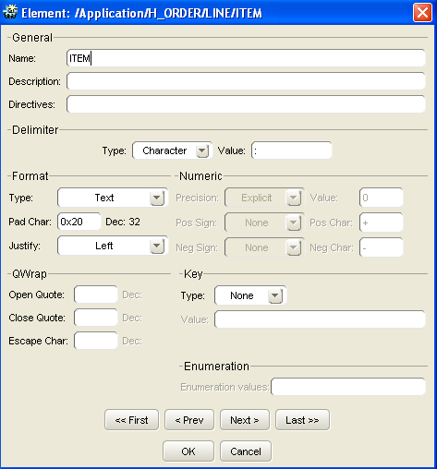
General Mapping Steps
Step3: set the properties of fields
field name
field delimiter
None
Landmark
Shared Services Center | Global Integration & eServices

Slide 17
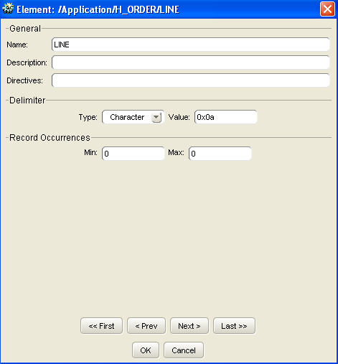
General Mapping Steps
Step4: set the properties of records
record name
record delimiter
record occurrence
?
field occurrence
Shared Services Center | Global Integration & eServices

Slide 18
General Mapping Steps
How to create a new map?
Shared Services Center | Global Integration & eServices

Slide 19
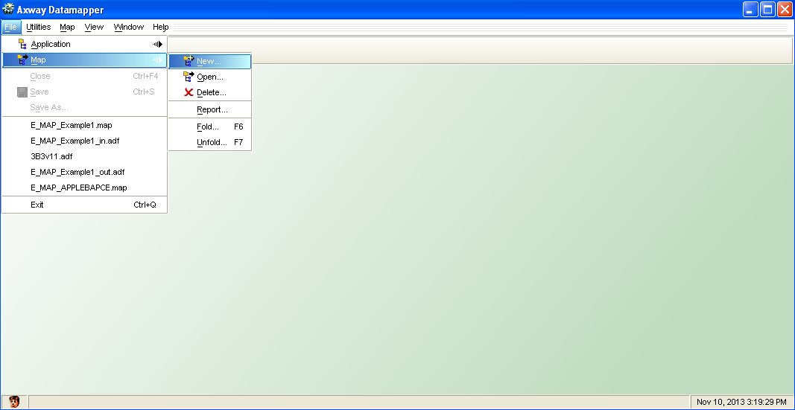
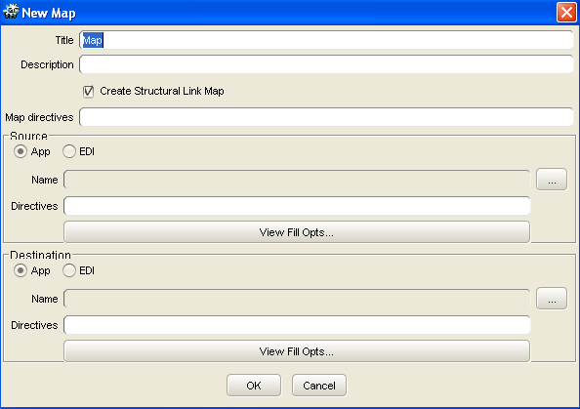

General Mapping Steps
Step1: choose source ADF
Step1: choose destination ADF
Shared Services Center | Global Integration & eServices

Slide 20
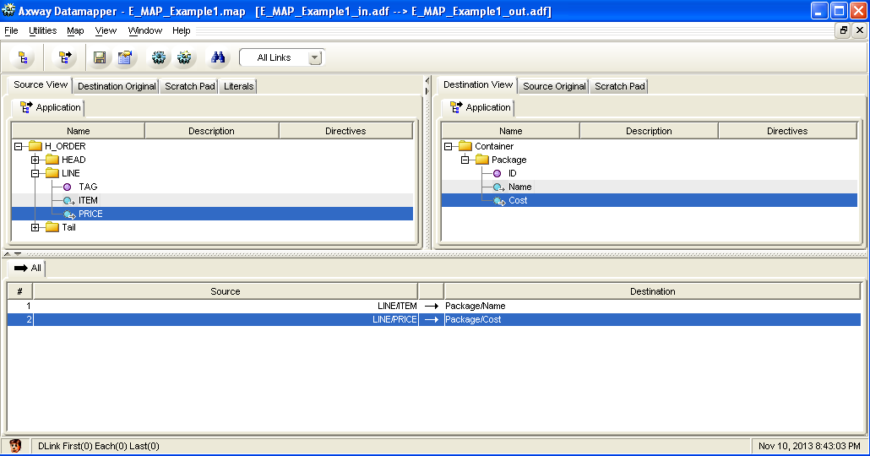
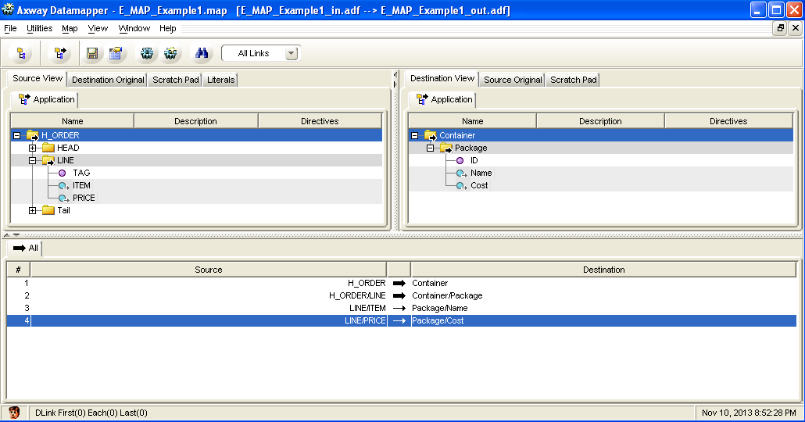
General Mapping Steps
Step2: create data links
Link between fields
Move values from “source” to “destination”
Rules:
to be able to link between two data fields we need to make a structure link from every source container ancestor to every destination container ancestor
Step3: create structural links
Link between records
Shared Services Center | Global Integration & eServices

Slide 21

General Mapping Steps
Step4:build RTM
Remarks:
If you forget to make a structural link from or to a used record, you get an error message when you build the RTM
Shared Services Center | Global Integration & eServices

Slide 22
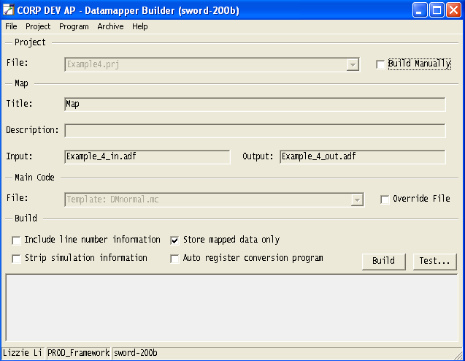
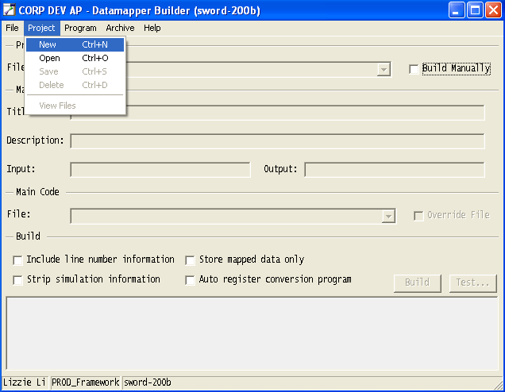
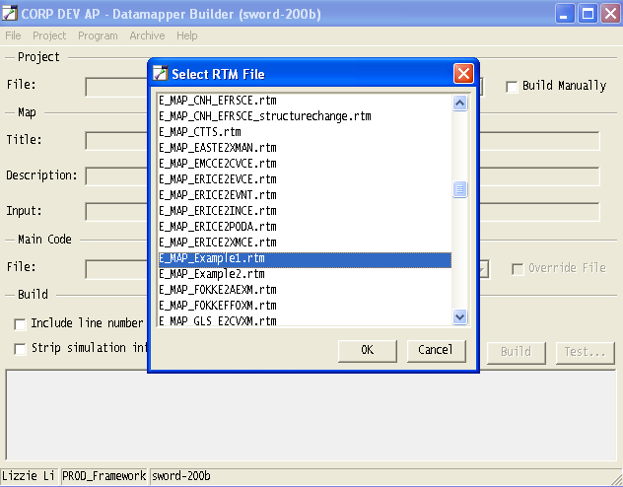
General Mapping Steps
Step5:generate project according to RTM
Information of the project
Settings from Datamapper Builder
Shared Services Center | Global Integration & eServices

Slide 23
General Mapping Steps
Step6:build project
Compiling information
Coding errors will be shown
*.x4 will be generated if no errors
Shared Services Center | Global Integration & eServices

Slide 24



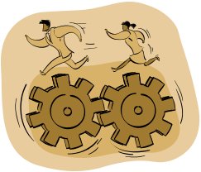


General Mapping Steps
How does mapping tools work
Example1_in.adf
Example1.rtm
Example1.prj
Example1.x4
compiling
Map program
Example1_out.adf
Client: Datamapper
Server: Datamapper Builder
Shared Services Center | Global Integration & eServices

Slide 25
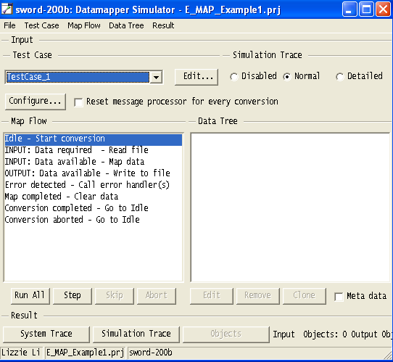
General Mapping Steps
Step7:Test
Step8:create a test case
Import the incoming file
Step9:run .x4
The outgoing file is generated
Shared Services Center | Global Integration & eServices

Slide 26
General Mapping Steps
What did we cover?
Shared Services Center | Global Integration & eServices

Slide 27
General Mapping Steps
How to create a new map?
Activity | Output
create the source and destination ADF | *.adf
analyze the request | N/A
create links between the two ADFs | *.rtm
compile RTM | *.x4
test map | outgoing files
Shared Services Center | Global Integration & eServices

Slide 28
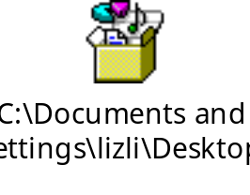
General Mapping Steps
Exercise 1
Shared Services Center | Global Integration & eServices

Slide 29
General Mapping Steps
Homework
Shared Services Center | Global Integration & eServices

Slide 30
General Mapping Steps
1. What are the difference between original and view?
2. What are the difference between default and landmark in field property?
3. When will we use fixed length in field delimiter?
4. Prepare “Defining structural links” for the next part.
Shared Services Center | Global Integration & eServices

